Slide 1


GOODCAB TRIP ANALYTICS
VEENA CHANDRA

Slide 2

GOODCAB TRIP ANALYTICS
GOAL AND OBJECTIVES
INTRODUCTION
Business Request and power bi problem statement
TASK
INSIGHTS AND RECOMMENDATIONS
CONCLUSION

Slide 3

GOAL
Goodcabs, established two years ago, is a cab service company dedicated to providing quality transportation while uplifting local economies in tier-2 Indian cities.
Objective
This presentation aims to analyse Goodcabs' performance across key metrics—trip volume, passenger satisfaction, repeat passenger rate, trip distribution, and the balance between new and repeat passengers—to identify areas for growth and improvement.

Slide 4
TASK
Task Breakdown:
Data Analysis:
Review the data and analyze datasets thoroughly to understand key metrics: trip volume, passenger satisfaction, repeat passenger rate, trip distribution, and balance between new and repeat passengers.
Question Reference:
We Started analysis by referring to the 'primary_and_secondary_questions.pdf' for guidance. We use tools like SQL, Power BI to answer these questions.
Dashboard Design:
Created a clear, self-explanatory dashboard showcasing your metrics and analysis for easy understanding.
Ad-Hoc Requests:
We Refer to the 'ad-hoc-requests.pdf' to address business-specific questions and generate necessary SQL-based reports.
Presentation:
Prepare a convincing presentation to present the findings to the Chief of Operations.

Slide 5

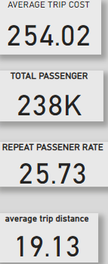
KEY INSIGHTS
New Passengers: We have on boarded 177K new passengers, which is a key indicator of our growth in the market.
Repeat Passengers: 61K repeat passengers show that many customers are satisfied and returning.
New vs. Repeated Trips Ratio: A ratio of 2.89 indicates that while we are acquiring new customers, repeat business is growing steadily.
Max and Min Trip Distances: he longest trip is 45 km, and the shortest is 5 km, which reflects the variety of service offerings.
Average Fare per KM: The average fare per kilometer is ₹13.28, which we need to monitor for pricing strategy adjustments.

Slide 6
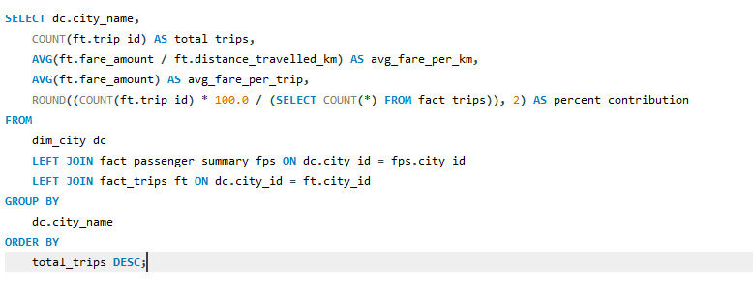
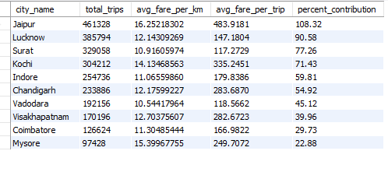
Business Requests
Business Request - 1: City-Level Fare and Trip Summary Report: Generate a report that displays the total trips, average fare per km, average fare per trip, and the percentage contribution of each city's trips to the overall trips. This report will help in assessing trip volume, pricing efficiency, and each city's contribution to the overall trip count.

Slide 7
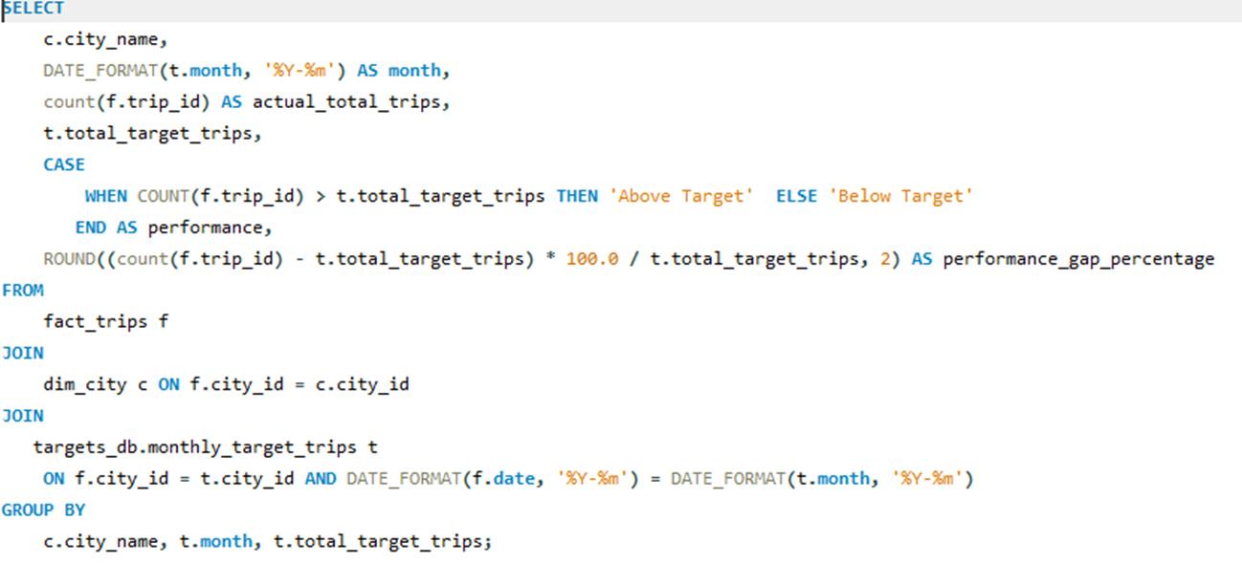
Business Requests
Business Request - 2: Monthly City-Level Trips Target Performance Report
Generate a report that evaluates the target performance for trips at the monthly and city level. For each city and month, compare the actual total trips with the target trips and categorise the performance as follows:
If actual trips are greater than target trips, mark it as "Above Target".
If actual trips are less than or equal to target trips, mark it as "Below Target".
Additionally, calculate the % difference between actual and target trips to quantify the performance gap.

Slide 8
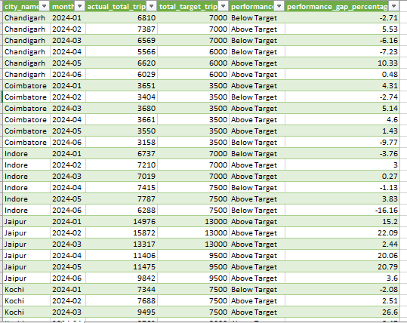
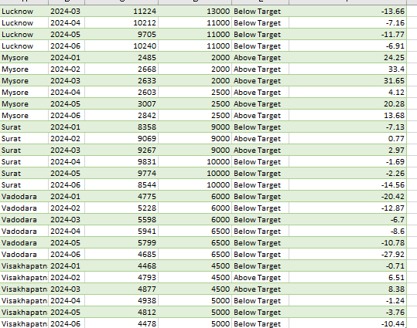

Slide 9
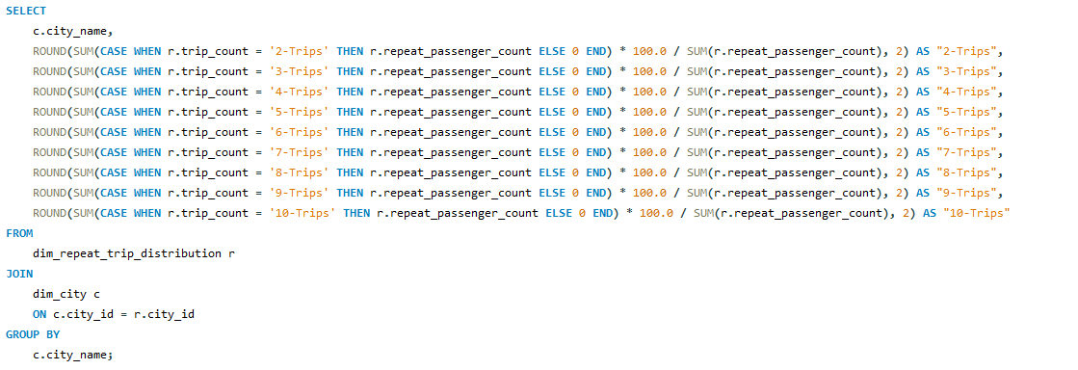
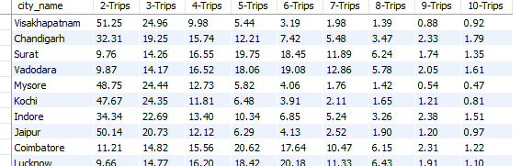
Business Requests
Business Request - 3: City-Level Repeat Passenger Trip Frequency Report
Generate a report that shows the percentage distribution of repeat passengers by the number of trips they have taken in each city. Calculate the percentage of repeat passengers who took 2 trips, 3 trips, and so on, up to 10 trips.
Each column should represent a trip count category, displaying the percentage of repeat passengers who fall into that category out of the total repeat passengers for that city.
This report will help identify cities with high repeat trip frequency, which can indicate strong customer loyalty or frequent usage patterns.

Slide 10
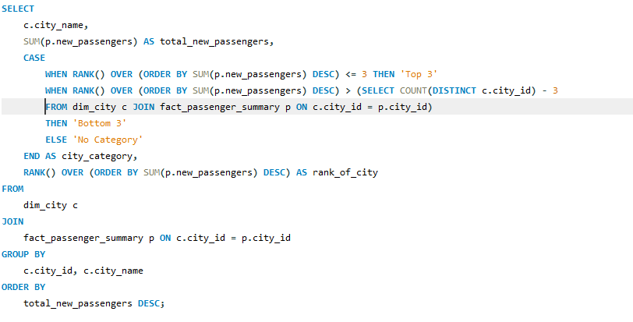
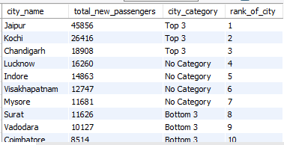
Business Requests
Business Request - 4: Identify Cities with Highest and Lowest Total New Passengers
Generate a report that calculates the total new passengers for each city and ranks them based on this value. Identify the top 3 cities with the highest number of new passengers as well as the bottom 3 cities with the lowest number of new passengers, categorising them as "Top 3" or "Bottom 3" accordingly.

Slide 11
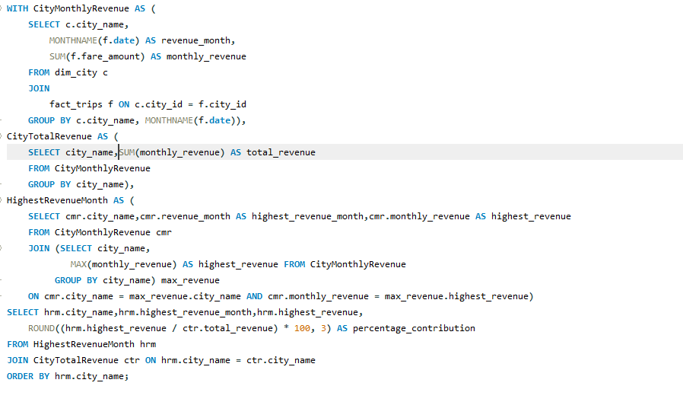
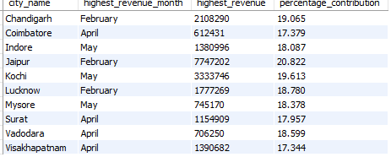
Business Requests
Business Request - 5: Identify Month with Highest Revenue for Each City
Generate a report that identifies the month with the highest revenue for each city. For each city, display the month_name, the revenue amount for that month, and the percentage contribution of that month's revenue to the city's total revenue.

Slide 12
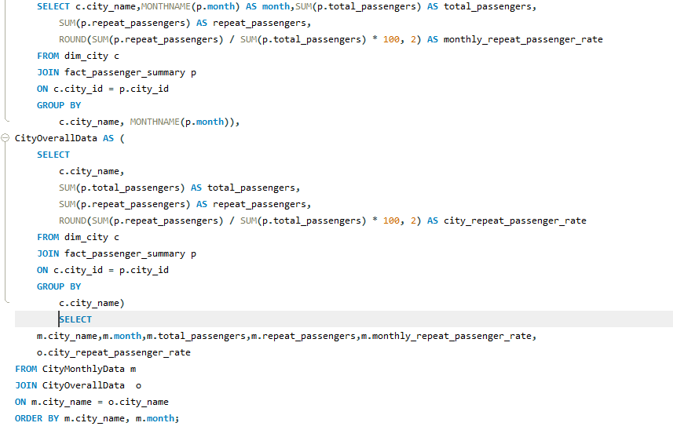
Business Requests
Business Request - 6: Repeat Passenger Rate Analysis
Generate a report that calculates two metrics:
Monthly Repeat Passenger Rate: Calculate the repeat passenger rate for each city and month by comparing the number of repeat passengers to the total passengers.
City-wide Repeat Passenger Rate: Calculate the overall repeat passenger rate for each city, considering all passengers across months.

Slide 13
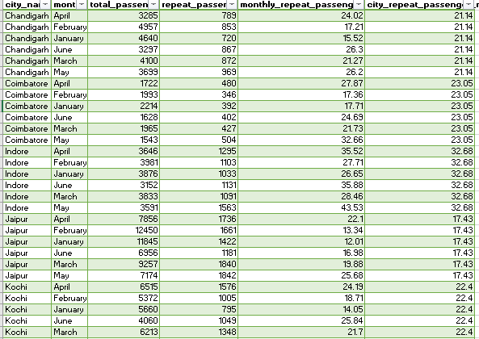
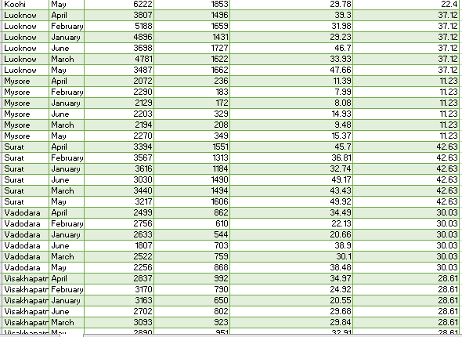
Business Requests
Business Request - 6: Repeat Passenger Rate Analysis
Generate a report that calculates two metrics:
Monthly Repeat Passenger Rate: Calculate the repeat passenger rate for each city and month by comparing the number of repeat passengers to the total passengers.
City-wide Repeat Passenger Rate: Calculate the overall repeat passenger rate for each city, considering all passengers across months.

Slide 14
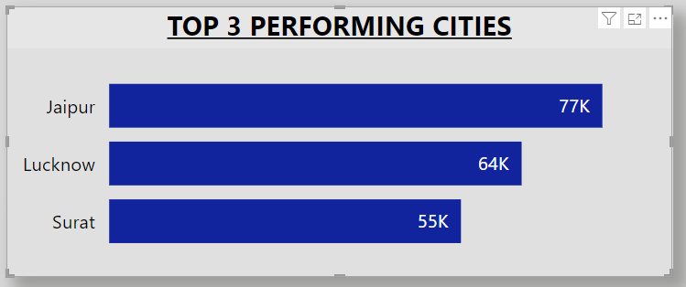
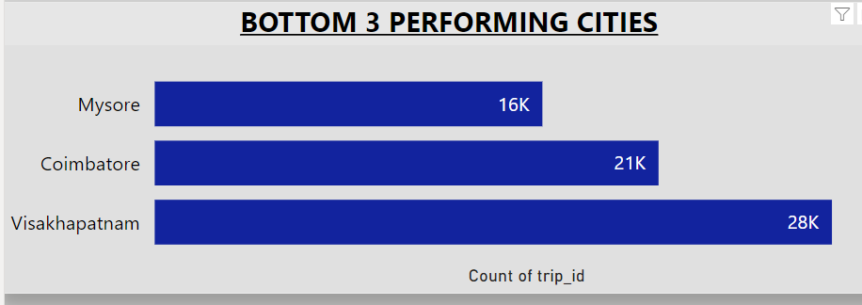
Primary and Secondary Questions
1.top and Bottom Performing Cities-identify the top 3 and bottom 3 cities by total trips over the entire analysis period.
Jaipur leads with 77K trips due to high demand and satisfaction, followed by Lucknow and Surat, driven by urban growth and industrial activities. Mysore (16K), Coimbatore, and Visakhapatnam underperform, requiring better marketing, service improvements, and localized strategies.

Slide 15
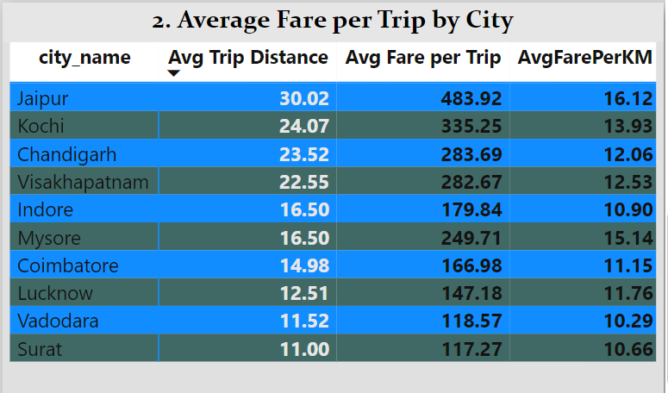
Primary and Secondary Questions
2.Average Fare per Trip by City
Calculate the average fare per trip for each city and compare it with the city's average trip distance. Identify the cities with the highest and lowest average fare per trip to assess pricing efficiency across locations.
Visakhapatnam led with 28,366 trips (43.17%), 74.69% higher than Mysore's 16,238 trips, followed by Coimbatore with 21,104 trips

Slide 16
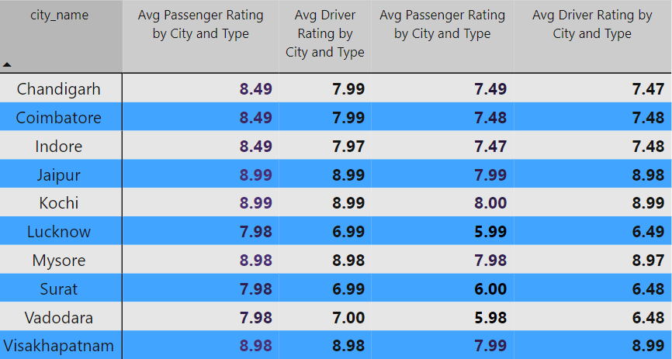
Primary and Secondary Questions
3.Average Ratings by City and Passenger Type
Calculate the average passenger and driver ratings for each city, segmented by passenger type (new vs. repeat). Identify cities with the highest and lowest average ratings.
Based on the analysis, the cities with the highest average ratings are Mysore, Coimbatore, and Chandigarh. These cities consistently deliver excellent service quality, reflecting strong customer satisfaction and approval. Their high ratings highlight efficient operations and positive passenger experiences. On the other hand, the cities with the lowest average ratings are Vadodara, Visakhapatnam, and Surat. These cities face challenges in maintaining service quality, as indicated by lower passenger satisfaction levels. This suggests potential issues such as delays, driver behaviour, or vehicle conditions that need to be addressed.

Slide 17
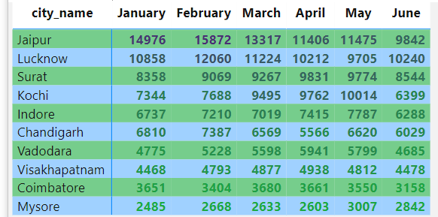
Primary and Secondary Questions
4.Peak and Low Demand Months by City
For each city, identify the month with the highest total trips (peak demand) and the month with the lowest total trips (low demand). This analysis will help Goodcabs understand seasonal patterns and adjust resources accordingly.
The analysis highlights cities with distinct demand patterns. Jaipur, Lucknow, and Surat experience peak demand in January and February, indicating higher trip volumes during the winter months. In contrast, Visakhapatnam, Coimbatore, and Mysore show consistently low demand, particularly during May and June, likely due to reduced travel in summer. To optimize operations, cities with peak demand should ensure adequate driver availability, while low-demand cities can introduce promotions or incentives to boost ridership during off-peak periods.

Slide 18
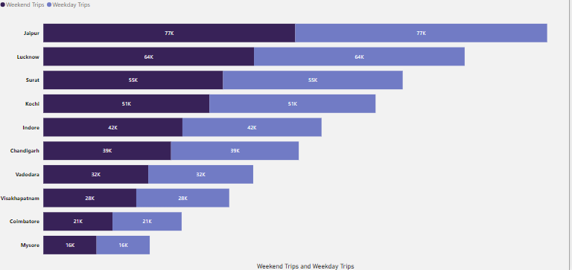
Primary and Secondary Questions
5.Weekend vs. Weekday Trip Demand by City
•Compare the total trips taken on weekdays versus weekends for each city over the six-month period. Identify cities with a strong preference for either weekend or weekday trips to understand demand variations.
The analysis reveals a strong weekday preference in cities like Indore (42K trips) and Chandigarh (39K trips), driven by professional commuters. Conversely, Kochi (51K trips) and Vadodara (32K trips) show a strong weekend preference, likely for leisure travel. To address these trends, weekday-focused cities can enhance commuter services with subscription plans and peak-hour discounts, while weekend-focused cities can promote leisure packages and ensure driver availability during weekends. Balancing these preferences can improve efficiency and satisfaction.

Slide 19
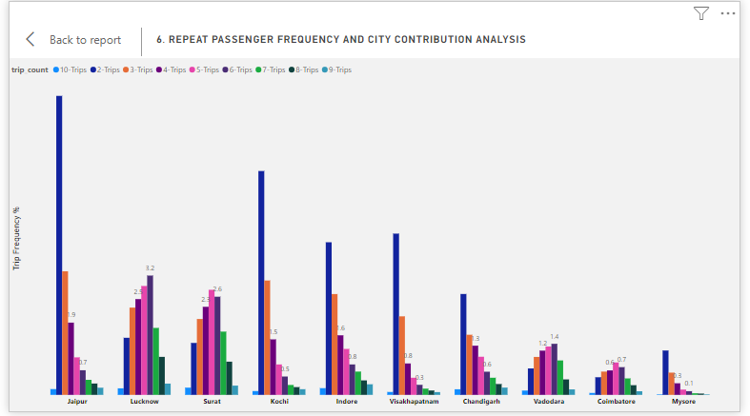
Primary and Secondary Questions
6.Repeat Passenger Frequency and City Contribution Analysis
Analyse the frequency of trips taken by repeat passengers in each city (e.g., % of repeat passengers taking 2 trips, 3 trips, etc.). Identify which cities contribute most to higher trip frequencies among repeat passengers, and examine if there are distinguishable patterns between tourism-focused and business-focused cities.
The analysis shows that cities like Jaipur and Lucknow have the highest contributions to repeat passengers taking multiple trips, with significant percentages opting for 2 or more trips. This indicates strong passenger loyalty and frequent usage. To maintain this trend, focusing on personalized offers and loyalty rewards in these cities can further enhance trip frequencies among repeat passengers.

Slide 20
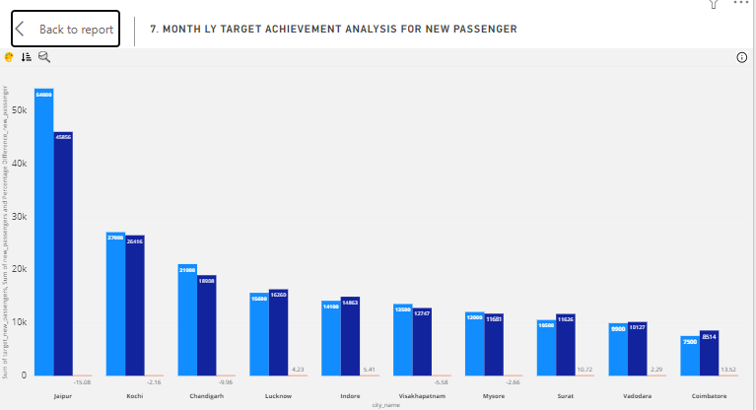
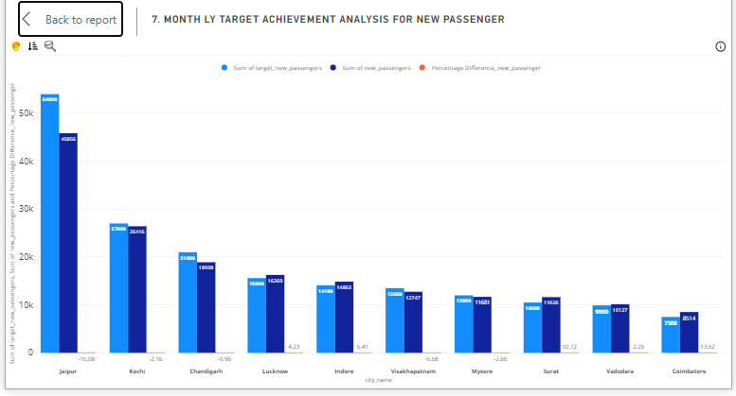
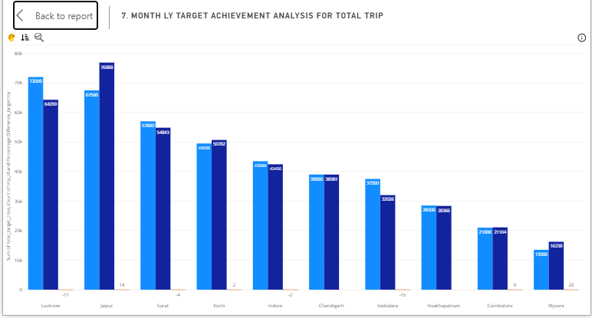
Primary and Secondary Questions
7.Monthly Target Achievement Analysis for Key Metrics
For each city, evaluate monthly performance against targets for total trips, new passengers, and average passenger ratings from targets db. Determine if each metric met, exceeded, or missed the target, and calculate the percentage difference. Identify any consistent patterns in target achievement, particularly across tourism versus business-focused cities.
The monthly performance analysis reveals mixed results across key metrics. Total trips and new passengers exceeded targets in cities like Jaipur and Lucknow, demonstrating strong growth, while cities like Coimbatore and Mysore fell short, with a noticeable gap in meeting targets. For average passenger ratings, most cities either met or marginally missed the target, reflecting consistent service quality overall. Percentage differences indicate areas for improvement, particularly in underperforming cities, where enhanced marketing and service optimization can help bridge gaps.

Slide 21
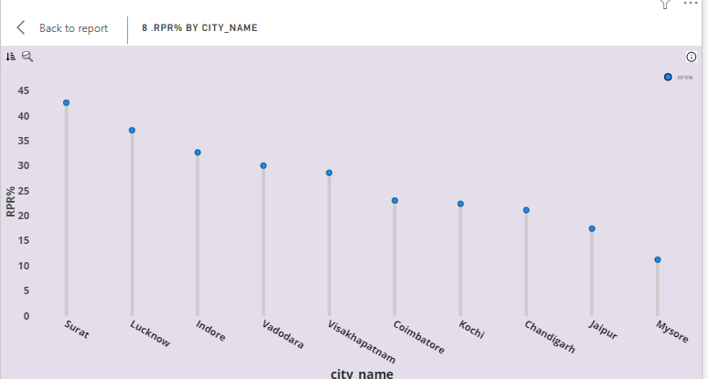
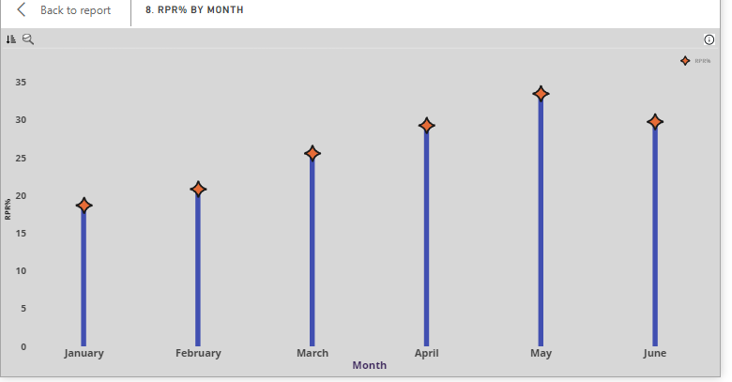
Primary and Secondary Questions
8.Highest and Lowest Repeat Passenger Rate (RPR%) by City and Month
Analyse the Repeat Passenger Rate (RPR%) for each city across the sixmonth period. Identify the top 2 and bottom 2 cities based on their RPR% to determine which locations have the strongest and weakest rates.
Similarly, analyse the RPR% by month across all cities and identify the months with the highest and lowest repeat passenger rates. This will help to pinpoint any seasonal patterns or months with higher repeat passenger loyalty.
The cities with the highest RPR% are Surat and Lucknow, showing strong repeat passenger loyalty. The lowest RPR% are found in Mysore and Coimbatore, indicating weaker repeat passenger retention. Analyzing RPR% by month, March shows the highest repeat passenger rate, while June records the lowest, suggesting seasonal fluctuations in repeat ridership. Focusing on loyalty programs in low-performing cities and during off-peak months could help improve retention.

Slide 22

1.Factors Influencing Repeat Passenger Rates • What factors (such as quality of service, competitive pricing, or city demographics) might contribute to higher or lower repeat passenger rates in different cities? Are there correlations with socioeconomic or lifestyle patterns in these cities?
Several factors influence repeat passenger rates across cities, including quality of service, competitive pricing, and city demographics.
Quality of Service: Cities with high service ratings, like Mysore and Coimbatore, see stronger repeat passenger rates. Consistent punctuality, well-maintained vehicles, and courteous drivers play a key role in customer loyalty.
Competitive Pricing: Cities with lower fares, like Surat and Indore, tend to attract more repeat passengers, as affordable services increase ride frequency. Promotions and discounts can further drive customer retention.
City Demographics: Cities with a higher concentration of professionals or students, such as Chandigarh, may have more frequent riders due to daily commutes, leading to a higher repeat passenger rate.
Socioeconomic Patterns: Wealthier cities may show lower repeat rates due to a greater variety of transport options, while cities with fewer alternatives, like Vadodara, may have higher repeat rates as people rely more on cabs.
Lifestyle Patterns: Urban areas with a dynamic lifestyle, such as Kochi, often see higher repeat passenger rates due to increased leisure and weekend trips, while smaller cities with limited social activities may experience lower repeat trip frequency.
Overall, a correlation exists between socioeconomic status, lifestyle patterns, and the demand for repeat trips, with cities offering a blend of affordability, service quality, and commuter demand seeing higher repeat rates.

Slide 23

2.Tourism vs. Business Demand Impact • How do tourism seasons or local events (festivals, conferences) impact Goodcabs' demand patterns? Would tailoring marketing efforts to these events increase trip volume in tou rism-oriented cities?
Tourism seasons and local events like festivals or conferences significantly impact Goodcabs' demand patterns, especially in tourism-oriented cities. Increased demand during peak tourist seasons or events suggests that tailoring marketing efforts, such as offering special promotions or targeted campaigns during these times, could boost trip volume and attract more tourists in cities with high tourism activity.

Slide 24
3. Emerging Mobility Trends and Good cabs' Adaptation • What emerging mobility trends (such as electric vehicle adoption, green energy use) are impacting the cab service market in tier-2 cities? Should Good cabs consider integrating electric vehicles or eco-friendly initiatives to stay competitive?
Emerging mobility trends like electric vehicle (EV) adoption and the growing emphasis on green energy are shaping the cab service market, even in tier-2 cities. To stay competitive, Goodcabs should consider integrating electric vehicles and eco-friendly initiatives, as this would not only align with global sustainability goals but also appeal to environmentally-conscious passengers and potentially reduce operational costs in the long run

Slide 25
4. Partnership Opportunities with Local Businesses Are there opportunities for Good cabs to partner with local businesses (such as hotels, malls, or event venues) to boost demand and improve customer loyalty? Could these partnerships drive more traffic, especially in tourism heavy or high-footfall areas?
Yes, Goodcabs can explore partnerships with local businesses like hotels, malls, and event venues to boost demand and improve customer loyalty. Collaborating in tourism-heavy or high-footfall areas can drive more traffic, offering exclusive discounts or packages for customers, increasing ridership and enhancing brand visibility.

Slide 26
5. Data Collection for Enhanced Data-Driven Decisions • To make Good cabs more data-driven and improve its performance across key metrics (such as repeat passenger rate, customer satisfaction, new passengers and trip volume), what additional data should Good cabs collect? Consider data that could provide deeper insights into customer behaviour, operational efficiency, and market trends.
Goodcabs should collect additional data on customer demographics, trip purpose, driver performance, and ride ratings to gain deeper insights into customer behavior. Tracking ride duration, route efficiency, and traffic patterns can improve operational efficiency. Additionally, collecting market trends and competitor analysis will help in adapting to shifting demands and enhancing strategic decision-making for growth.

Slide 27
INSIGHTS AND CONCLUSION
Conclusion and Insights
Strong Passenger Growth: Goodcabs has seen substantial growth in new passengers (177K) while maintaining a solid base of repeat passengers (61K). The balance between new and repeat passengers (2.89 ratio) shows a healthy service mix.
Peak Demand Cities: Cities like Jaipur, Surat, and Lucknow experience peak demand during the start of the year (January-February), while others like Visakhapatnam and Mysore face lower demand in summer months (May-June). Tailored strategies for high and low-demand periods can optimize operations.
City-Specific Preferences: Kochi and Vadodara exhibit strong weekend preferences, whereas Indore and Chandigarh are more weekday-focused. Understanding these patterns helps in aligning driver resources and promotions effectively.

Slide 28
INSIGHTS AND CONCLUSION
Conclusion and Insights
Passenger Satisfaction: Mysore, Coimbatore, and Chandigarh lead in passenger ratings, suggesting high service quality, while Vadodara and Surat need improvement in customer satisfaction.
Repeat Passenger Behavior: Jaipur and Lucknow have the highest repeat passenger frequency, particularly for those taking 2 or more trips, indicating strong loyalty. Targeting loyalty incentives in these cities will further boost repeat business.
Improvement Areas: Focus on enhancing service quality and customer satisfaction in cities with lower ratings and repeat passenger contributions. Promotions and targeted campaigns during off-peak seasons in low-demand cities can also improve ridership.

Slide 29
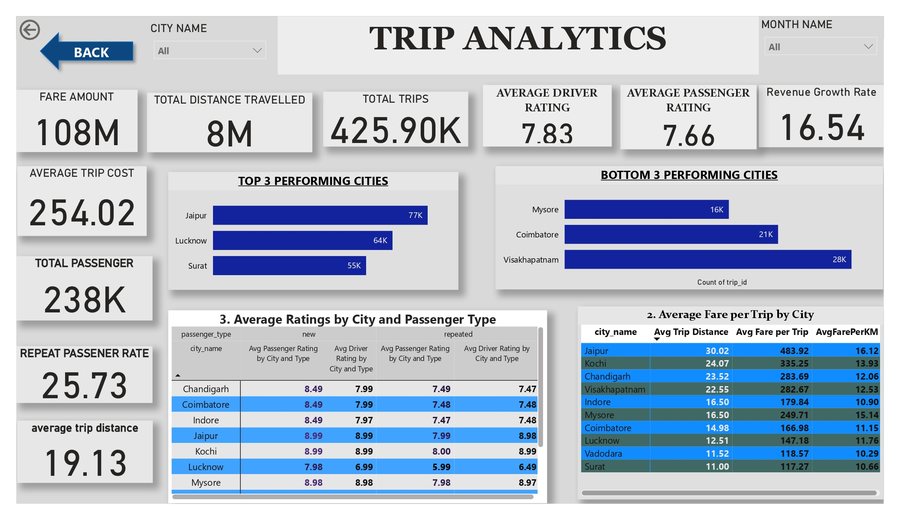
DASHBOARD

Slide 30
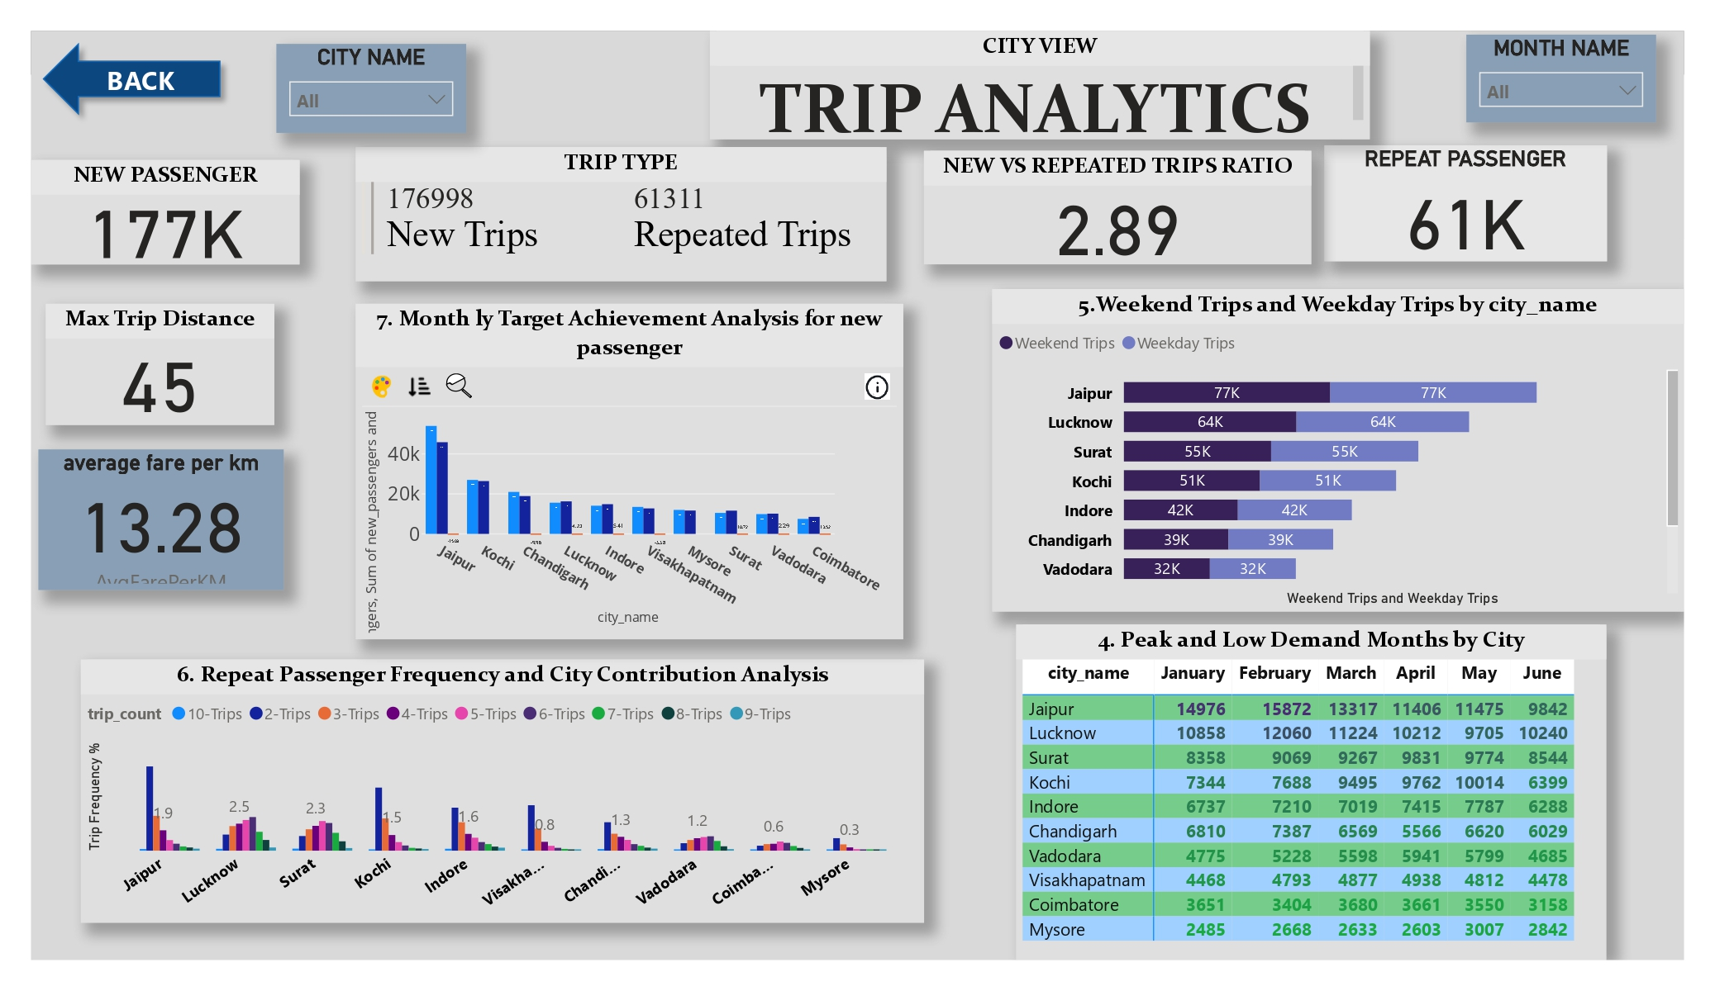
DASHBOARD

Slide 31
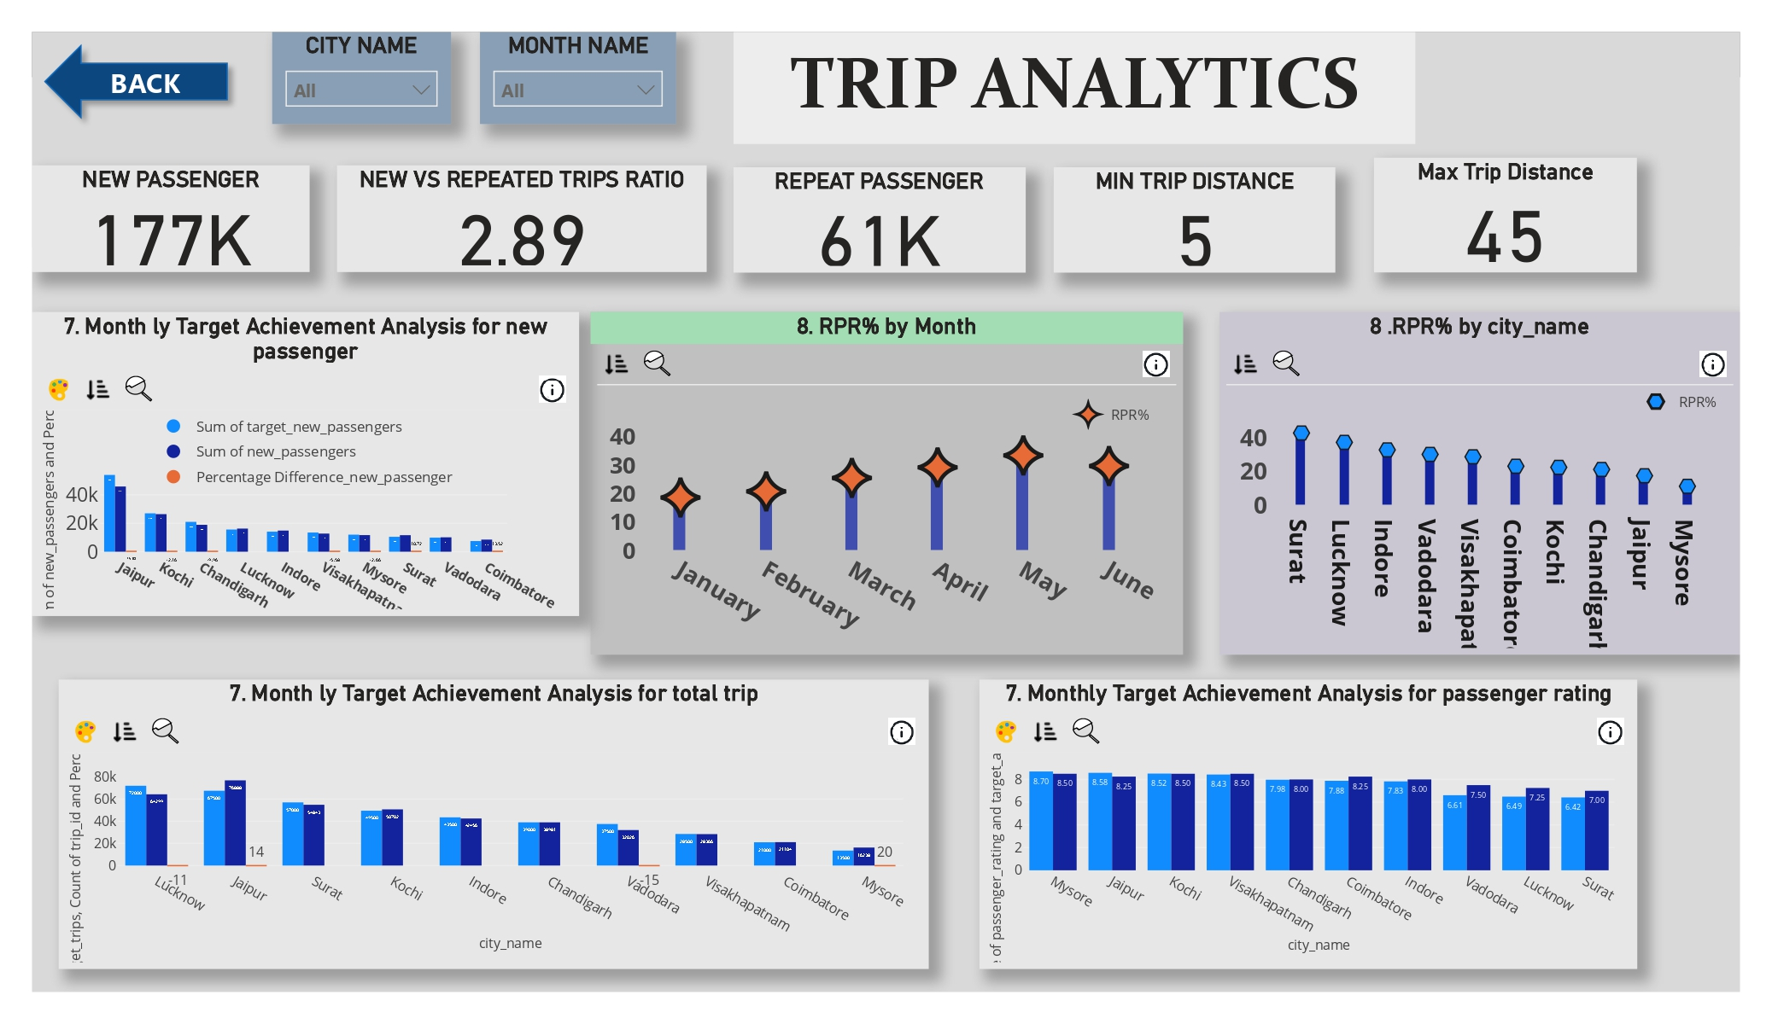
DASHBOARD

Slide 32
THANK YOU
🌟 Huge thanks to Codebasics, Dhaval Patel, and Hemanand Vadivel for their inspiring challenges that push me to sharpen my data analytics skills!

